Slide 1
99 problems,
but a heart ain’t one
Princess Otusanya
Patrick Kim

Slide 2
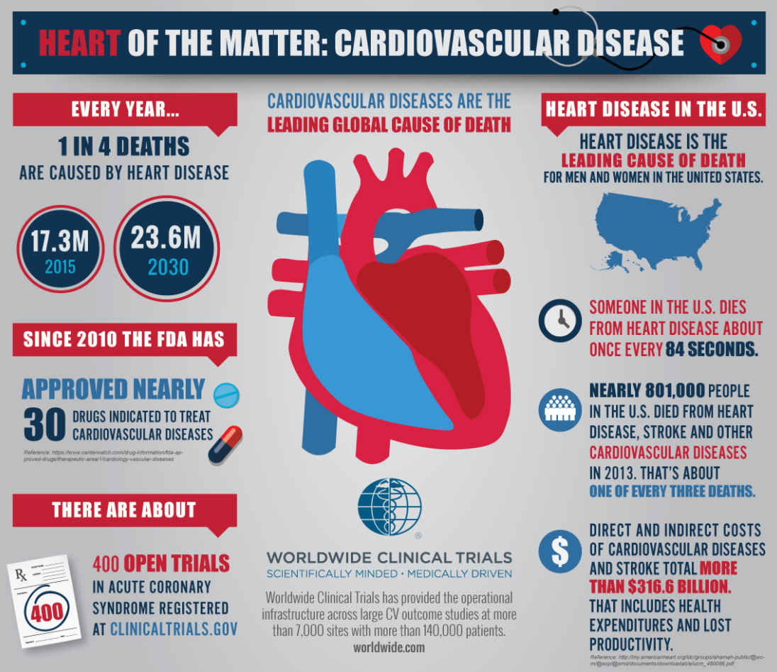

Slide 3
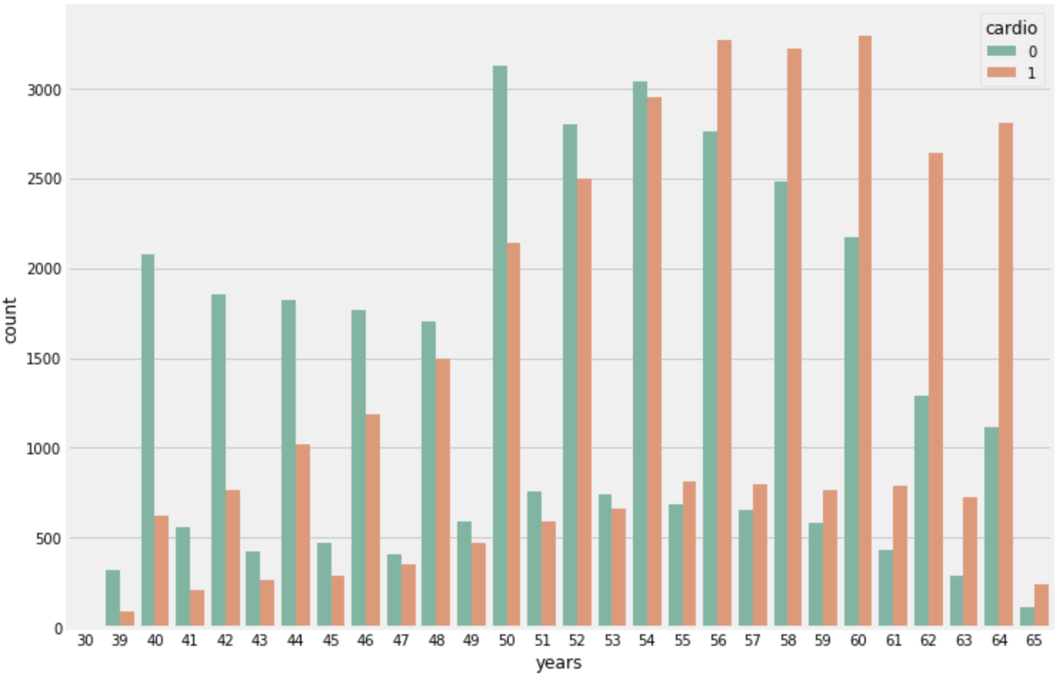
Exploratory Data Analysis

Slide 4
Key Questions
Do people with cardiovascular disease have a higher Body Mass Index (BMI) than people without cardiovascular disease?
Given high blood pressure, do males have an equal chance of getting cardiovascular disease as females?
Does the proportion of people with high cholesterol levels equal to the proportion of people who have normal cholesterol levels?

Slide 5


BMI
H₀ : People with cardiovascular disease have the same BMI as the people without the disease.
H₁ : People with cardiovascular disease have higher BMI than the people without the disease.
26.81
average BMI for people without cardiovascular disease
28.56
average BMI for people with cardiovascular disease
T-stat:45.928
P-val: 0.000
Effect Size: 0.362
Power: 1.0

Slide 6

BMI

Slide 7

Gender and Blood Pressure
H₀ : Males with high blood pressure are equally likely to be diagnosed with cardiovascular disease as women.
H₁ : There is a difference in proportion between males with high blood pressure and cardiovascular disease and the proportion of females with high blood pressure and cardiovascular disease.
Z-stat: 4.203
P-val: 0.000026
Effect Size: 0.034
Power: 0.654

Slide 8

Gender and Blood Pressure

Slide 9
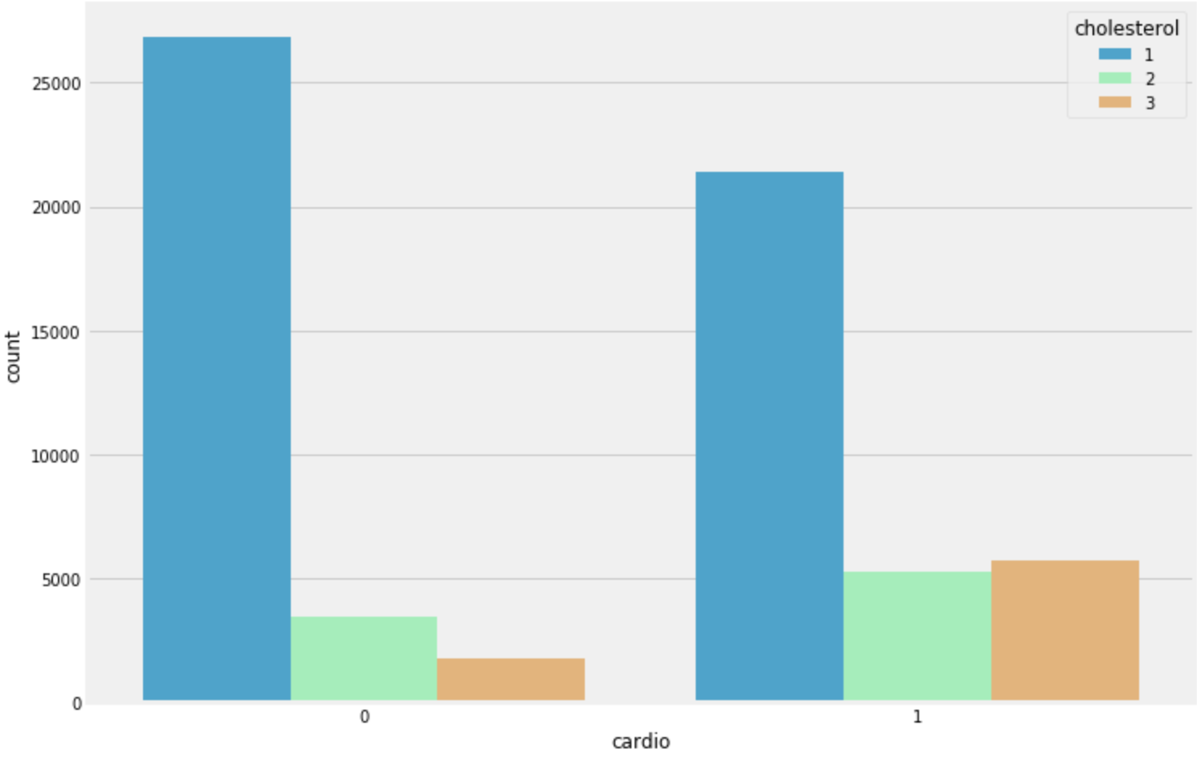
Cholesterol
H₀ : People with high levels of cholesterol are equally likely to be diagnosed with cardiovascular disease as people with normal levels of cholesterol.
H₁ : People with high levels of cholesterol are more likely to be diagnosed with cardiovascular disease as people with normal levels of cholesterol.
Z-stat: 51.822
P-val: 0.000
Effect Size: 0.479
Power: 1.0

Slide 10
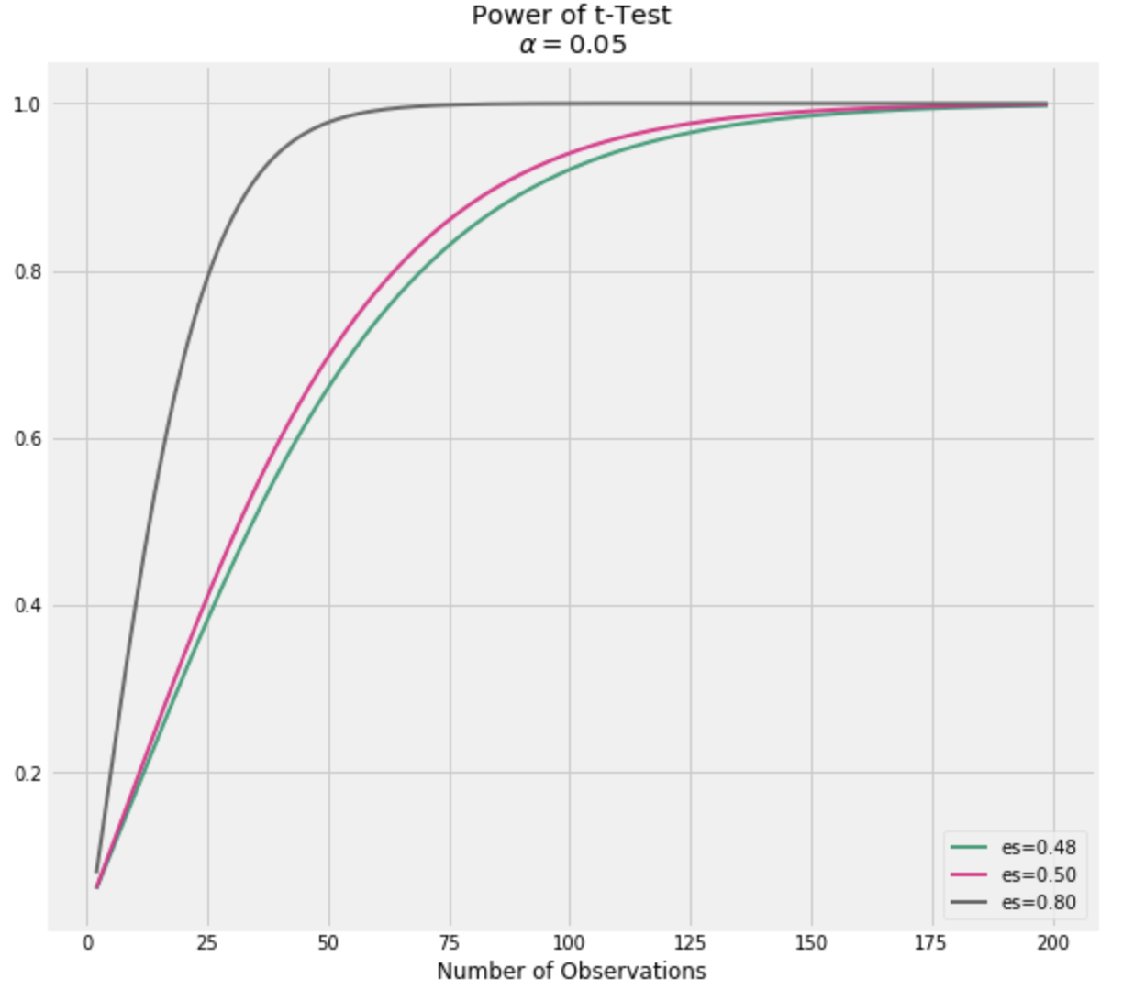
Cholesterol

Slide 11
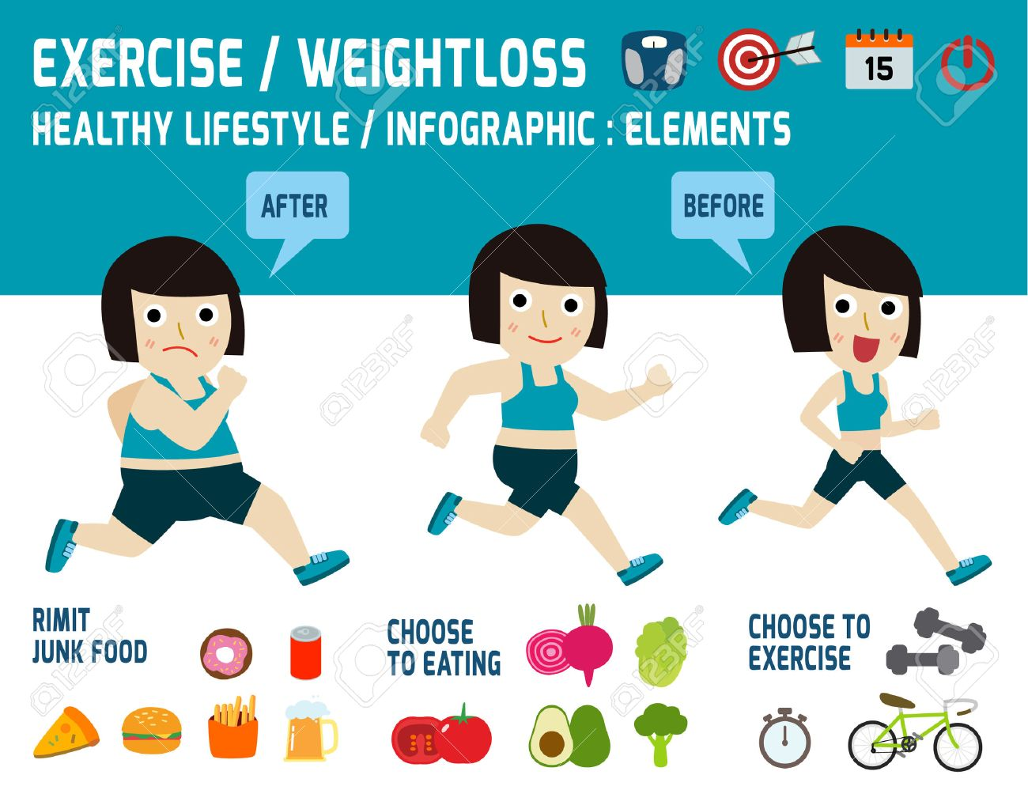
Conclusions
Advising patients to lower BMI through a healthy lifestyle (diet and exercise) is highly encouraged to lower your chances of getting cardiovascular disease.
There is a difference in proportions between males with high blood pressure and cardiovascular disease and females with high blood pressure and cardiovascular disease.
High cholesterol levels increase your chances of getting cardiovascular disease. Again through diet and exercise, this may help lower levels.

